Slide 1

Career Hub
Supervisor
Mam Zarsha Nazim
Submitted by
Muhammad Haseeb
{Fa-2018/BSSE-068}
Sehar Naveed
{Fa-2018/BSSE-064}
Department of Software Engineering
Lahore Garrison University

Slide 2
Outline
Abstract
Introduction
Project Scope
Problem statement
Features
Tools & Techniques
Project Milestone
Conclusion
References

Slide 3
Abstract
Selecting the best and suitable career is a crucial decision for students to enhance their learning skills and participate in emerging fields of life. Career selection once done wisely goes long way as it determines a path for a student to follow and achieve desired goal. Career Hub is a third-party app that will act as an intermediate between students and instructors. It is a platform for students to get information about the career options they are looking into and also directions to follow the specific path with the help of recommended courses, books and certifications.

Slide 4
Introduction
Career Hub is a student career recommendation third-party app that uses machine learning to recommend the right career for the students on the basis of experience and knowledge that are performing extraordinary in their professional fields and are able to suggest each student the career that will polish his skills and help him in gaining better reputation professionally. A full-stack application which will use machine learning, data models to predict the best career once he create account input the details about his previous academic record and skills.

Slide 5
Project scope
Early on in academic life, every student must set a target and map-out his steps towards the goal he wants to achieve. Choosing the right career is a decision that is pivotal in this process. The sole purpose of this app is to facilitate that very decision. It is user-friendly, saving the students from hassle of technicalities of technology. Top of all, they can find motivation out of success stories of some field experts in this app.

Slide 6
Problem Statement
There is always a difficulty for the students to choose their career that will help them to build their professional skills.
Career Counselors are there to guide the students about the profession based on their interests but they don’t provide them the content that is going to be helpful for them to achieve the career goals.
Many students who are determined about their career didn’t find any authentic content related to their career that is helpful for them, most of the content available on the web didn’t polish your skills it just wastes your time.

Slide 7
Features
Instructor | Admin | Student
Login and signup Add new courses ,content and books Schedule live session Set-up his profiles for students | Login into the system Display details about admission test, entry test patterns and eligibility criteria's. | Create or login account. Use machine learning recommendation to choose best career. Access courses , information and content uploaded by instructor and admin. Save their courses for later access.

Slide 8
Tools & Techniques
Frontend Web Development (HTML/CSS/Bootstrap/JavaScript)
Backend Web Development (Django Web Framework)
Database Development (MySQL and MySQL lite)
Python for Machine Learning (Anaconda Navigator)
Mobile Application Development (Android Studio)

Slide 9
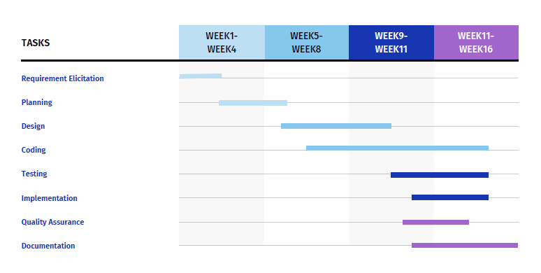
Project Milestone

Slide 10
Conclusion
The whole study concludes that career hub will help student to choose career wisely from the recommendation provided by the expert opinions and anyone who is aiming to achieve his goals can easily follow the path of career by exploring different courses, books and certifications. Students can get the latest updates regarding the admission opening in different universities, entry test information and eligibility criteria.

Slide 11
References
https://www.ilmkidunya.com/
http://www.entrytest.com/
https://www.coursera.org/
https://www.udemy.com/
https://www.udacity.com/

Slide 12
Questions?

